Slide 1
Sound Pollution Detector
Group no: 01
Members name and ID:
Townim Faisal Chowdhury (1721327042)
A.S.M Irfan (1520297042)
Yakut Marzan (1430034042)

Slide 2
INTRODUCTION
Transportation systems are the main source of noise pollution
World Health Organization stated that “Noise must be recognized as a major threat to human well-being”
Our app will show a decibel value by measuring the environmental noise using Android operating system

Slide 3
GOALS
The app will indicate decibel by gauge
Display the current noise reference
Display user a message about the noise
Display decibel by graph line

Slide 4
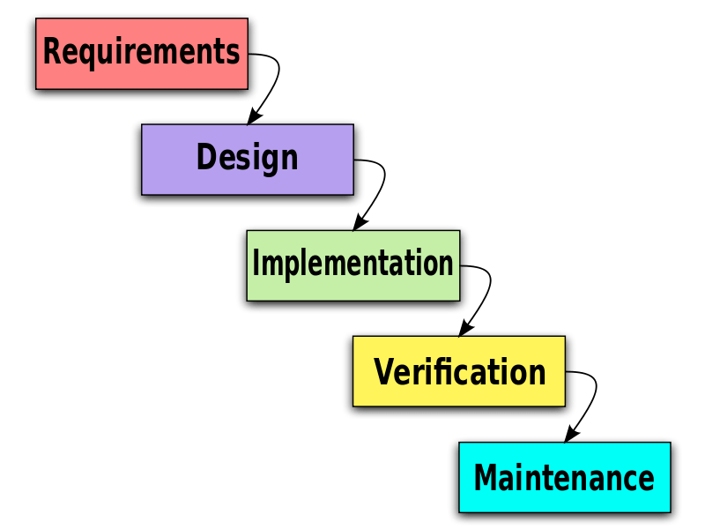
MODEL
We have followed “Waterfall Model”

Slide 5
MODEL INTEGRATION
Requirement Gathering and Analysis: We collected all possible requirements of the system to be developed in this phase and documented in a requirement specification document.
System Design: We studied the requirement specifications from first phase in this phase and the system design is prepared. This system design helps in specifying hardware and system requirements and helps in defining the overall system architecture.
Implementation: With inputs from the system design, the system was first developed in small programs called units, which are integrated in the next phase.

Slide 6
MODEL INTEGRATION
Verification: All the units developed in the implementation phase were integrated into a system after testing of each unit. Post integration the entire system is tested for any faults and failures.
Deployment and Maintenance: Once the verification had done; the product was deployed. In maintenance, we have not done any significant work as the product was not launched in the market.

Slide 7
REQUIREMENT DEFINITION
API level 24(Nougat) and 26(Oreo)
Minimum SDK version 19
Android studio
Device using Android operating system
Device supporting Microphone

Slide 8
ALGORITHM DESIGN
Sound pressure value
Change the sound pressure value to decibel value
Value= 0 to 14.9
Whisper Quiet
Value= 15 to 29.9
Quiet Area
Value= 30 to 40.9
Ideal Calm
Value= 41 to 64.9
Normal
Value= 65 to 69.9
Loud
Value= 70 to 79.9
Very Loud
Value= 80 to 89.9
Should Move Away

Slide 9

PRODUCT LAUNCHING
We are going to launch the product as an android app in Google Play Store
https://play.google.com/store?hl=en

Slide 10
FEASIBILITY
It is feasible in our time frame to achieve our goal
The complexity level is low compared to other related work and this is user friendly as well.

Slide 11
FUTURE IMPLEMENTATION
Notify to other user’s about the area
Detect and classify the sound
Send an alert to the local police about the noise pollution
Improve the accuracy of measuring noise

Slide 12
PROJECT CONTRIBUTION
Name | Project Contribution
Townim Faisal Chowdhury | Logical implementation of project in code, Project report, Project presentation
A.S.M. Irfan | UI/UX design, Project report, Project presentation
Yakut Marzan | UI/UX design, Project report, Project presentation

Slide 13


